Slide 1
SOVEREIGN CITIZENS
Gregory Lucas
Captain
Criminal Investigations Division

Slide 2
Objectives
Understand sovereign citizen ideology
Identify sovereign citizens
Determine safety factors when dealing with sovereigns

Slide 3
Sovereign Citizen Defined by USLegal.com
Sovereign citizen is a term used to refer to a political movement which grew out of a belief in government abuses of power. Members often refuse to hold social security cards or driver’s licenses and avoid using ZIP codes. Sovereign citizens believe that U.S. citizens are either “Fourteenth Amendment citizens” (who are subject to the federal and state laws and taxes) or “sovereign citizens,” who are subject only to common law or “constitutional law” (or both), but are not bound to obey statutory law. No court has ever upheld these claims. Sovereign citizens may also be referred to as “freemen” or “common law citizens.”
Notes:
They say that they are not 14th Amendment Citizens, unless it suits their purpose, I will show you later in the presentation.

Slide 4
Video

Slide 5
Video
Southern Poverty Law Center
Excellent roll-call training video
Available on request: Chief Investigator Intelligence Project (334) 956-8331

Slide 6
Sovereign Beliefs
Sovereigns do not believe
In the authority of most government officials or courts
In having to obtain or possess government documents
In paying federal, state, local or property taxes
Sovereigns believe
In Common Law
No victim, no crime
Debt Redemption

Slide 7
Uniform Commercial Code - UCC
UCC –Uniform Commercial Code
First published in 1952, is one of a number of uniform acts that have been promulgated with the goal of harmonizing the law of sales and other commercial transactions across the United States of America (U.S.) through UCC adoption by all 50 states, the District of Columbia, and the U.S. territories.
Notes:
You will see UCC used in several ways by sovereigns, UCC is the basis for beliefs of sovereigns, such as not having to have a DL, etc. they ignore all other codes

Slide 8
Documents
Sovereign citizens send copies of letters addressed to creditors and government agencies to the Office of the Attorney General (OAG)
No known statute for such requirement
Redemption essay states that Redeemers are encouraged to notify public officials
Belief that sovereigns recognize the Attorney General to be the highest authority in the state
Letters reviewed by OAG attorneys, kept in Law Enforcement Division
Notes:
Paper Terrorists -- Talk about redemption later

Slide 9
Apostille
Issued by the Texas Secretary of State
Used to certify signatures on documents for use in foreign countries
The Apostille states
Not for use in the United States of America
This Apostille only certifies the signature, the capacity of the signer and the seal or stamp it bears. It does not certify the content of the document for which it was issued.
Notes:
Documents are used to legitimize their documents, I have received Apostilles from several sovereigns so I know they use them, there may be others.

Slide 10
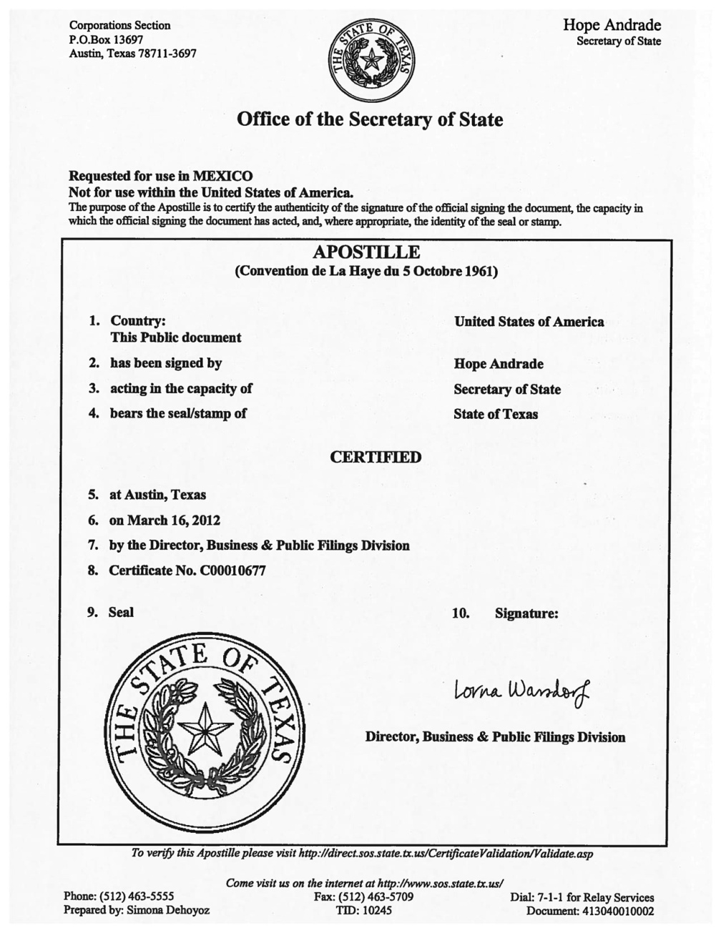
Apostille
Notes:
Looks Official, two State of Texas seals, placed on top of documents to make them look official, may not be the only official looking document used by sovereigns ---remember video

Slide 11
Uniform Commercial Code UCC-1 Financing Statement
A legal form that a creditor files to give notice that it has or may have an interest in the personal property of a debtor
Filed with the Texas Secretary of State
Usually used for sales of large items, such as vehicle sales inventory, large business or farming machines sales, etc.
Both parties will sign this statement
Used as the basis for filing a lien for non-payment

Slide 12
Uniform Commercial Code Form UCC-1 Financing Statement
Filed with the Secretary of State (SOS)
Filed by sovereigns prior to filing fraudulent liens
Requires the signature of the debtor
Since 2005, the SOS may send documents they deem to be fraudulent to the OAG for review without filing them
Sec. 37.101 Fraudulent Filing of a Financing Statement
Many states do not have such laws
Check credit regularly

Slide 13
Mechanics Lien
Filed with county clerk
Clerk may request supporting documentation, including document with debtor’s signature
SB 1589, effective 9/1/2005, a county clerk may delay recording a suspicious lien pending review by county or district attorney
Contact county clerk
Notes:
Who has heard of mechanic’s lien? Either issued by court of signed mutually by debtor and creditor

Slide 14
TPC Section 37.101
Sec. 37.101. FRAUDULENT FILING OF FINANCING STATEMENT
A person commits an offense if the person knowingly presents for filing or causes to be presented for filing a financing statement that the person knows is forged, contains a material false statement; or is groundless.
An offense is a felony of the third degree if it is forged.
An offense is a Class A misdemeanor if it is materially false or is groundless, unless the person commits the offense with the intent to defraud or harm another, in which event the offense is a state jail felony.
Notes:
Texas Law, not all states have a similar law

Slide 15
Liens
In New York, police officer Anthony Kalimeras went to kick squatters Ed-George Parenteau and Jeffrey Charles Burfeindt out of a foreclosed home in Ulster County March 4, 2009.
They had a fake deed and homemade identification. They gave only their first and middle names — Edward George and Jeffrey Charles. And they gave birthdates of 11/28/5958 and 2/16/5964. He arrested them for trespassing and false personation.
Kalimeras remembers that they kept saying: You wouldn’t understand. He didn’t.
Until months later, when the two men filed liens against Kalimeras; his employer, the town of Lloyd; and more than a dozen other municipalities and individuals for $135 billion.
Notes:
Example in New York, who does not have a similar statute

Slide 16
Debt Redemption Theory
Belief that in 1933, the U.S. went off of the gold standard, the country was declared bankrupt
U.S. ruled by common law, became a corporation enforced by the Uniform Commercial Code (UCC)
Currency that was issued is not money, but notes of credit
Belief that birth certificate number is account number that can be accessed to discharge debt through the U.S. Treasury
Sovereigns believe that there is $630,000 in that account, others believe $1,000,000

Slide 17
Non-Negotiable Notice of Acceptance
Debt redemption scheme
A notice sent by sovereigns to the IRS and creditors
The purpose is to have their credit “discharged,” not paid.

Slide 18
Non-Negotiable Notice of Acceptance
Notes:
Most of the letters received by OAG are these notices

Slide 19
Debt Redemption Theory
“I request that all Public Charges be set-off and adjusted by the Public exemption in accord with UCC-3-419, House Joint Resolution 192 & Public Law 73-10.”
Wesley Snipes
Explanation of defense from prosecutor in Wesley Snipes income tax evasion trial:
There is no actual money in America today, just “notes”
Consequently there is no way to “pay” an obligation, just “discharge” one
But the books have to balance - and, somewhere, there is an account for each and every one of us that can be used to balance the books, without utilizing Federal Reserve Notes
“Bills of Exchange” either access that account, or call upon the Treasury to make the ledger entries that offset the supposed debt

Slide 20
Homemade Financial Instruments
Billy Ray Dawson, aka Sheik Tehuti, using the Debt Redemption Theory,
issued this $78,400 homemade money order to pay off mortgage
Home in Ft. Worth was foreclosed on for nonpayment

Slide 21
Homemade Financial Instruments
Two Examples of Fraudulent Financial Instrument Created by Inmates
From USDOJ Bureau of Prison Bulletin: BOP CTU - Sovereign Citizen Financial Instruments, November 2011

Slide 22
Homemade Financial Instruments

Slide 23
Homemade Financial Instruments

Slide 24
Debt Redemption Theory
Article written 1999 by Mark Pitcavage, Ph.D.
“Old Wine, New Bottles: Paper Terrorism, Paper Scams and Paper Redemption”
www.adl.org/mwd/redemption.asp

Slide 25
Sovereigns
Sovereign citizens are not a tight-knit group, but are part of a large number of citizens who share anti-government sentiments.
The estimate is that there are approximately 300,000 in the U.S.
Different levels of radicalization
Documents received by the OAG indicate that many are citizens, many times couples, who subscribe mainly to the Debt Redemption Theory.
However, there are some who are willing to die for these beliefs.

Slide 26
MOORS
The Moorish National Republic
The Moorish Divine and national movement of the world
Aboriginal and indigenous natural peoples of North America
Notes:
Moors are usually non-violent, but most are not cooperative with LE - Every MOOR I am aware of is Black, except one

Slide 27
MOORS
After receiving two traffic citations from a Colleyville Police officer, the OAG received paperwork from James Michael Tesi indicating that he is a member of:
Moorish Americans
The Moorish Divine and National Movement of the World
Aboriginal Natural Peoples of the Land-North America/Northwest mexem
Notes:
Still talking about documents, the reason I bring up Moors is because of the following document

Slide 28
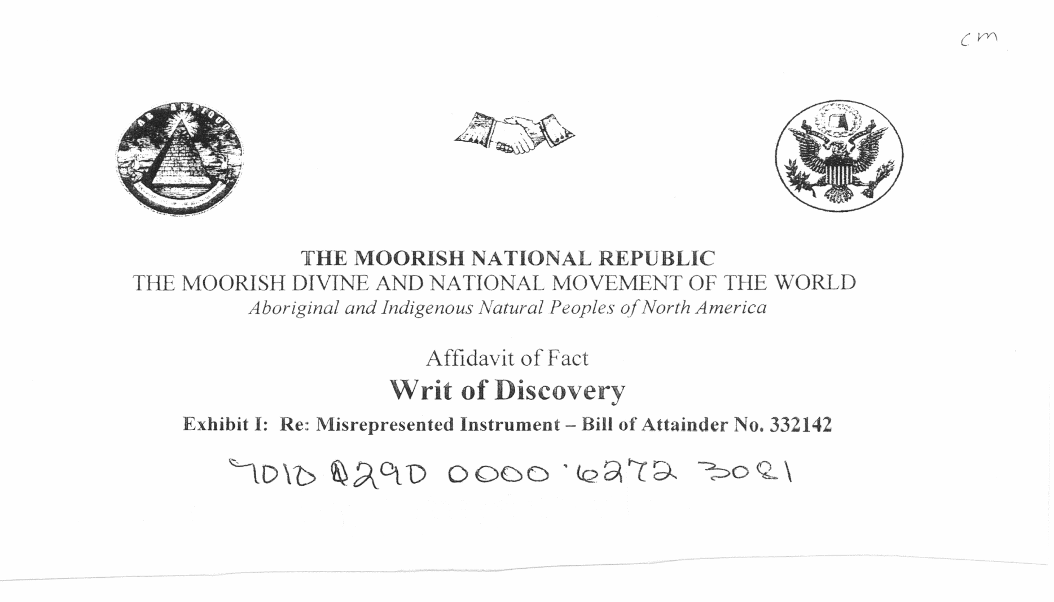
MOORS
Notes:
Tesi received two citations from Colleyville PD Officer, sent this document to PD, copy to OAG lengthy document, just going to show 1st page

Slide 29
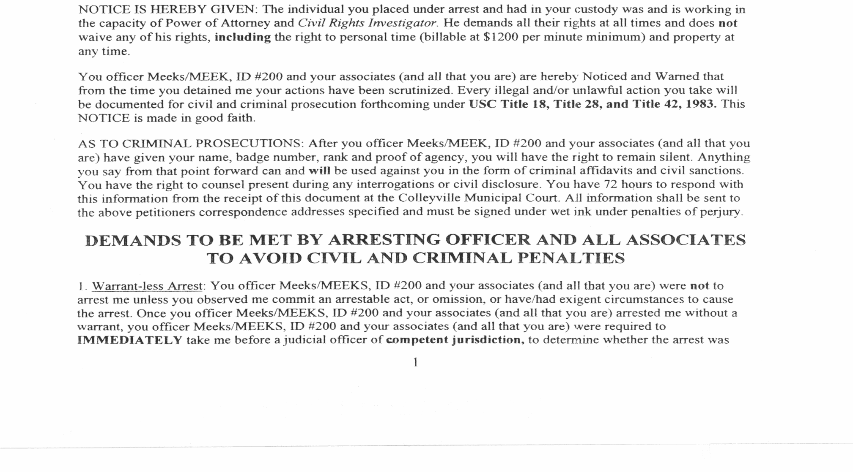
MOORS
Notes:
1st of many pages – I hate to read verbatim from the screen, this is important - read all

Slide 30
MOORS
James Michael Tesi
aka
James Michael, House of Tesi
aka
James Michael Joseph Tesi El
Notes:
Remember all are black except one? This is the ONE

Slide 31
MOORS
July 24, 2011
Tesi was wanted in Colleyville for Class C Misdemeanor warrants only
Officer attempted to conduct a traffic stop, Tesi drove to his home
Tesi exited his vehicle, starting firing handgun at the officer
Tesi was hit in face and foot, officer not injured
Notes:
2 traffic warrants, no criminal history, no confrontation when citations were issued, no confrontation before shots fired

Slide 32
Ecclesiastical Notice
Quotes from the 165 Points made by a sovereign citizen in a document addressed to the Texas Attorney General entitled:
Notice and Demand
“Ecclesiastical Notice for the Principal is Notice for the Agent and Notice for the Agent is Notice for the Principal”
Notes:
Glenn Willingham Fearn

Slide 33
Ecclesiastical Notice
#112…“shall completely ignore your codes, rules, and regulations Because they do NOT apply to me, and if any of your hired thugs (color of law code enforcers) perceive any obedience by Me, to any of your codes, rules, or regulations, it shall be viewed to be a mistake or an accident.”

Slide 34
Ecclesiastical Notice
#113…“that I shall NOT obey any of your codes, rules or regulations, because the are all ‘color of law,’ and I have the right to resist any attempt to force Me to obey them, with lethal force if necessary, because I have an unlimited right to resist any unlawful arrest with lethal force if necessary. It is my sincere wish that I never have to exercise that right, but I do have that right.”

Slide 35
Ecclesiastical Notice
#115…“You and your subordinates have no more authority over ME than a Walmart rent-a-cop does.”
#116…“that in the event that one of your hired thugs, color of law code enforcers, attempts to unlawfully arrest Me, and I assert My right to resist that unlawful arrest, with lethal force if necessary, and your hired thug, color of law code enforcer kills me, your hired thug shall be guilty of MURDER, and so shall you.”

Slide 36
Ecclesiastical Notice
#125…“the current Thirteenth Amendment and all subsequent amendments to the US Constitution are all martial law amendments Under the color of law and have no authority.”
Notes:
Remember that sovereigns disavow any Constitutional amendment after 12

Slide 37
Sovereign System
THE REPUBLIC OF TEXAS
Congress
Senate and House of Representatives
Grand Jury
Common Law Courts
http://thetexasrepublic.com/
Notes:
Not many sovereign groups, but here are a few…… still get letters from prison from old leader Richard Lance McLaren

Slide 38
The Common Law Court for The Republic of Texas
2010 – Beginning of home foreclosure proceedings against a sovereign for not making mortgage payments for home in Kerr County
2014 - Court found in favor of the title company
Subpoenas issued by the “Chief Justice” for the “Common Law Court for the Republic of Texas” for the attorney representing title company and the presiding district court judge reference home foreclosure of sovereign citizen
The judge was subpoenaed for February 14, 2015
Search Warrant for documents only
Simulating Legal Process – Class A Misdemeanor
Notes:
It took four years to get the foreclosure because mortgage company was deluged with documents – Paper Terrorism – David Kroupa plead guilty, Susan Cammack convicted at trial

Slide 39
Texian Jural Society Grand Jury
In 2011, the Lone Star Fugitive Task force arrested sovereign citizen John Rinn in Milam County
At the time Rinn was arrested, he was considered a material witness by the “Texian Jural Society Grand Jury.”
After arrest, U.S. Marshals were contacted by Greg Davis on John Rinn’s behalf

Slide 40
Texian Jural Society Grand Jury
John Rinn Rockdale, Texas
Milam County
“Sovereign Soul of the Dry Land”
Active Participant in the
“Texian Jural Society”

Slide 41
Texian Jural Society Grand Jury Communique to US Magistrate

Slide 42
Texian Jural Society Grand Jury

Slide 43
The Republic State of Texas
Gregory Brent Davis
Business Card

Slide 44
The Republic State of Texas
On March 28, 2012, members of the United States Marshals Service Lone Star Fugitive Task Force, Hays County Sheriff’s Department and Texas Department of Public Safety arrested 60-year-old Gregory Brent Davis in the 5300 block of Lone Man Mountain Road, Wimberley, Texas.
Davis had a total of three outstanding felony warrants and one outstanding misdemeanor warrant, all of which were out of Bexar County, Texas:
Impersonating a Public Servant (Texas Ranger) x 2
Unlawful Carry of a Weapon on Licensed Premise
Unlawful Carry of Weapon

Slide 45
The Republic State of Texas
Davis was located at a gate of the residence on Lone Mountain Road. When officers began to approach Davis, he ran away on foot.
Davis was later located lying on the ground under some trees near the property where he was last observed.
During the search for Davis, numerous weapons were located in the residence in which he was living. The weapons confiscated were three semi-automatic rifles, one shotgun, one .22 rifle and a semi-automatic handgun.
Notes:
Discuss - Three guns for every sovereign

Slide 46
Pembina Nation Little Shell Band
Russell and Tina Mortland
Pembina Nation Little Shell Band
September 2005, lived in totally self-contained (water & power) trailer in Driftwood, Hays County
Homemade license plates on both vehicles
Anti-government, but was employed as a mechanic with Capital Metro in Austin

Slide 47
Pembina Nation Little Shell Band
Russell Mortland
Tina Mortland

Slide 48
Pembina Nation Little Shell Band
Russell and Tina Mortland were indicted for Fraudulent Filing of a Financing Statement and Retaliation – OAG Investigation
Search warrant executed in 2005 by multiple local, county, state and federal LE agencies
Tense stand-off
Seized 7 rifles and two handguns
Roughly 8,000 rounds of full metal jacket ammunition Chinese or Russian surplus

Slide 49
Pembina Nation Little Shell Band

Slide 50
Pembina Nation Little Shell Band

Slide 51
John Joe Gray
Story in USA Today on March 30, 2012
John Joe Gray assaulted DPS trooper Christmas Eve 1999
Self-imposed exile on 50 acres with family in Trinidad since indictment
USA Today headline read: “If y’all come to get me, bring body bags”
Ruby Ridge, Branch Davidians in Waco
Notes:
Discuss issues with USA Today - I have been giving this presentation for several years, this is what I have been teaching

Slide 52
John Joe Gray Update
The longest running police standoff ended In January, 2016, after 15 years, but John Joe Gray doesn't want to leave his east Texas ranch.
Gray is still holed up and threatening to renew the standoff over $34,618 in unpaid taxes..

Slide 53
Penal Code Offenses
Possible offenses committed by sovereigns
These are options, not a comprehensive list
Do not necessarily all apply, as each situation is different
Discuss with prosecutors before situation arises

Slide 54
TPC Section 37.101
Sec. 37.101. FRAUDULENT FILING OF FINANCING STATEMENT
A person commits an offense if the person knowingly presents for filing or causes to be presented for filing a financing statement that the person knows is forged, contains a material false statement, or is groundless.
An offense is a felony of the third degree if it is forged.
An offense is a Class A misdemeanor if it is materially false or is groundless, unless the person commits the offense with the intent to defraud or harm another, in which event the offense is a state jail felony.

Slide 55
TPC Section 36.06
Sec. 36.06. OBSTRUCTION OR RETALIATION
(a) A person commits an offense if the person intentionally or knowingly harms or threatens to harm another by an unlawful act:
(1) in retaliation for or on account of the service or status of another as a:
(A) public servant, witness, prospective witness, or informant; or…….
An offense under this section is a felony of the third degree

Slide 56
TPC Section 32.49
32.49 REFUSAL TO EXECUTE RELEASE OF FRAUDULENT LIEN OR CLAIM
A person commits an offense if, with intent to defraud or harm another, the person:
(1) owns, holds, or is the beneficiary of a purported lien or claim asserted against real or personal property or an interest in real or personal property that is fraudulent, as described by Section 51.901(c), Government Code; and
(2) not later than the 21st day after the date of receipt of actual or written notice sent by either certified or registered mail, return receipt requested, to the person's last known address, or by telephonic document transfer to the recipient's current telecopier number, requesting the execution of a release of the fraudulent lien or claim, refuses to execute the release on the request of:

Slide 57
TPC Section 32.49 Continued
(A) the obligor or debtor; or
(B) any person who owns any interest in the real or personal property described in the document or instrument that is the basis for the lien or claim.
(b) A person who fails to execute a release of the purported lien or claim within the period prescribed by Subsection (a)(2) is presumed to have had the intent to harm or defraud another.
(c) An offense under this section is a Class A misdemeanor

Slide 58
TPC Section 37.10
Sec. 37.10. TAMPERING WITH GOVERNMENTAL RECORD
A person commits an offense if he makes, presents or uses any record, document or thing with knowledge of its falsity and with intent that it be taken as a genuine governmental record;
An offense under this section is a felony of the third degree if it is shown on the trial of the offense that the governmental record was a public school record, report or assessment instrument required under Chapter 39, Education Code, or was a license, certificate, permit, seal, title, letter of patent or similar document issued by government, by another state or by the United States, unless the actor’s intent is to defraud or harm another, in which event the offense is a felony of the second degree.

Slide 59
TPC Section 37.10 Continued
It is not a defense to prosecution that the record, document, or thing made, presented, or used displays or contains the statement “NOT A GOVERNMENT DOCUMENT” or another substantially similar statement intended to alert a person to the falsity of the record, document or thing, unless the record, document or thing displays the statement diagonally printed clearly and indelibly on both the front and back of the record, document or thing in solid red capital letters at least one-fourth inch in height.

Slide 60
TPC Section 37.10 Question
Does the presentation of an Apostille meet the standard for TPC Section 37.10 Tampering with a Government Document?
“Makes, presents, or uses any record, document, or thing with knowledge of its falsity and with intent that it be taken as a genuine governmental record”
“Not for use in the United States of America”
Discuss with prosecutors

Slide 61
TPC 37.11
Sec. 37.11. IMPERSONATING PUBLIC SERVANT
A person commits an offense if he impersonates a public servant with intent to induce another to submit to his pretended official authority or to rely on his pretended official acts
or knowingly purports to exercise any function of a public servant or of a public office, including that of a judge and court, and the position or office through which he purports to exercise a function of a public servant or public office has no lawful existence under the constitution or laws of this state or of the United States.
An offense under this section is a felony of the third degree.

Slide 62
TPC 37.12
Sec. 37.12. FALSE IDENTIFICATION AS PEACE OFFICER; MISREPRESENTATION OF PROPERTY
A person commits an offense if the person makes, provides to another person, or possesses a card, document, badge, insignia, shoulder emblem or other item bearing an insignia of a law enforcement agency that identifies a person as a peace officer or a reserve law enforcement officer; and
the person who makes, provides or possesses the item bearing the insignia knows that the person so identified by the item is not commissioned as a peace officer or reserve law enforcement officer as indicated on the item.

Slide 63
TPC 37.13
Sec. 37.13. RECORD OF A FRAUDULENT COURT
A person commits an offense if the person makes, presents or uses any document or other record with knowledge that the document or other record is not a record of a court created under or established by the constitution or laws of this state or of the United States;
and the intent that the document or other record be given the same legal effect as a record of a court created under or established by the constitution or laws of this state or of the United States.
An offense under this section is a Class A misdemeanor.

Slide 64
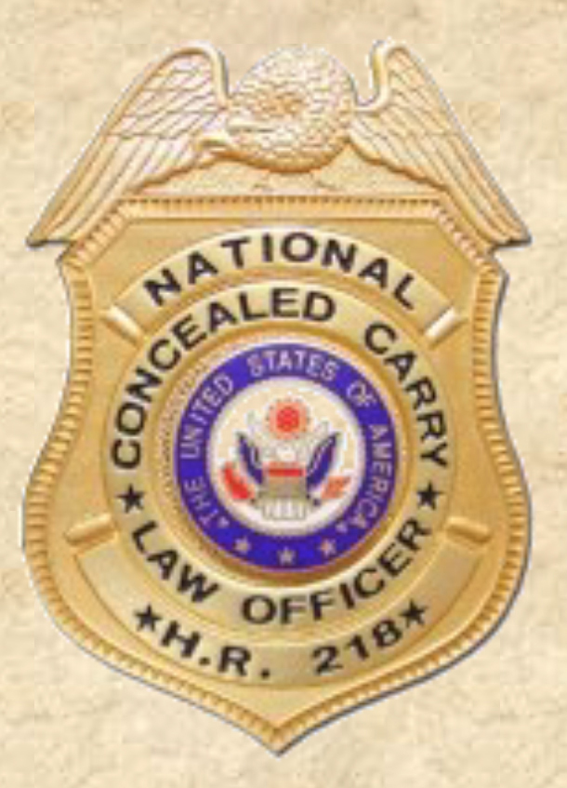
Badge
Question:
If, on a traffic stop, the driver
presented this badge,
would this be a violation?
Sec. 37.11. Impersonating
Public Servant?
Sec. 37.12. False Identification
as Peace Officer;
Misrepresentation of Property?

Slide 65
Sovereign Citizens
It is not a matter of IF,
but WHEN you will encounter a sovereign citizen.

Slide 66
Observation
If you observe any of the following, you will very likely confront a sovereign citizen.

Slide 67
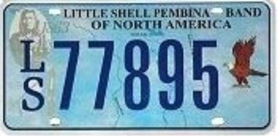
License Plates
Homemade License Plates
County Ranger, Indian or Tribal License Plates
“UCC”
“Exempt No license required”
Usually with no MVI sticker

Slide 68
License Plates
License Plate seized in Kerr County in April, 2015

Slide 69
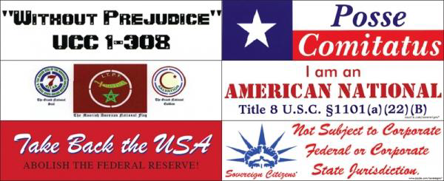
Bumper Stickers
Courtesy of CA Dept. of Corrections and Rehabilitation Bulletin 01/11/2011

Slide 70
Window Stickers
Republic of Texas can have different connotations

Slide 71
Lettering on Vehicle
Lettering on Vehicle stating
“This is not a commercial vehicle”
“Not Subject to Arrest or Seizure”

Slide 72
Initial Contact
Statements such as
“I am a free man travelling upon the land.”
“I do not believe I or my vehicle are subject to your jurisdiction.”
Questions such as
“What authority do you have to question a sovereign?”
“Is a driver’s license required of a sovereign?”

Slide 73
Initial Contact
Will attempt to provide voluminous paperwork to show sovereignty
Official appearance, such as the Apostille
Documents will many times have red ink or markings, or thumbprint in blood
Remember video from West Memphis PD

Slide 74
Initial Contact
USE CAUTION
Know that your life could be in danger
You do not know what point of radicalization that you will encounter
Always maintain tactical advantage
Put your ego in check

Slide 75
Sovereign Beliefs
Sovereign citizens do not believe in toll roads, maintaining state-
issued driver’s licenses, or registering their vehicles, claiming that utilization of roadways is a Constitutional right under the 14th Amendment and/or is a God-given right and cannot be regulated by the government.
FBI Situational Report June 28, 2011

Slide 76
Sovereign Beliefs
Sovereign citizens may recite rhetoric which appears to be memorized, refuse to provide identification and insurance documents, claim the officer is violating the sovereign citizen’s constitutional rights by issuing a ticket, and/or insist law enforcement officers sign documents provided by the sovereign citizen. When signing a citation, sovereign citizens may write “reservation of rights” or “all rights reserved” in addition to their signature, which they believe nullifies their signature.
FBI Situational Report June 28, 2011

Slide 77
Sovereign Beliefs
In April 2010, an identified US Person 1 was stopped by a San Antonio Police Department (SAPD) officer for a speeding violation in San Antonio, Texas. When the officer asked for US Person 1 driver’s license, US Person 1 refused to roll down his window and told the officer he did not have to provide any information because it was not a law. US Person 1 then rolled his window down a very small amount and stated he was in fear of his life, claiming the officer had a gun to assault him.
FBI Situational Report June 28, 2011

Slide 78
Addison PD Traffic Stop

Slide 79
Action
KNOWLEDGE – Be aware of agency policies
PLANNING - Know what actions you will or will not take before the confrontation occurs
Whatever action you are going to take………..
TAKE IT!

Slide 80
Action
When you stop a sovereign citizen,
WHAT WILL YOU DO?

Slide 81
Questions?
Captain Gregory Lucas
Law Enforcement Liaison
(512) 936-1335
gregory.lucas@texasattorneygeneral.gov
www.texasattorneygeneral.gov

Slide 82
Test
Question 1
Liens may be filed with the:
a) County Clerk
b) Texas Attorney General
c) Texas Secretary of State
d) a & c

Slide 83
Test
Question 2
If a sovereign unlawfully filed a lien against a person, the appropriate criminal charge would be:
a) Tampering with a Government Record
b) Fraudulent Filing of a Financing Statement
c) Non-Negotiable Notice of Acceptance
d) none of the above

Slide 84
Test
Question 3
Sovereigns are:
a) members of militant anti-government groups
b) every day citizens who believe that the government
has no authority over them
c) Dangerous
d) all of the above

